Slide 1


Simplifying News Digitalisation
Re-look into the way publications are displaying their articles
ISSS609 Text Analytics and Applications
Project Presentation
Prepared by:
Group 8
JIANG Nan | TEY Wei Jie | WANG Yechun
WANG Yuxin | YAO Yu | ZHU Chenzi
Notes:
Good evening Prof and fellow classmates. We are Group 8.
I am JIANG Nan. These are my group members xxxx.
Our topic is about Simplifying News Digitalisation.

Slide 2
Project analysis slide 2
Agenda
1. Introduction&
Solution Review
6. Limitations & Future work
Simplifying News Digitalisation
2. Workflow& Data
Preparation
5. Text Summarization
3. DEMO
4. Topic Modelling
Notes:
This is today’s agenda. First, we will briefly introduce the business scenario and solution overview. Second is workflow and data preparation. Next is the UI demo part. Then we will explain the techniques we have used: topic modelling, text summarizations and their limitations and future work.

Slide 3
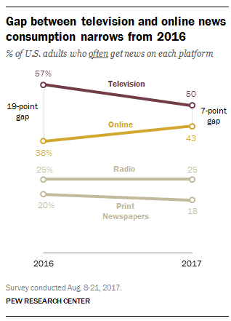
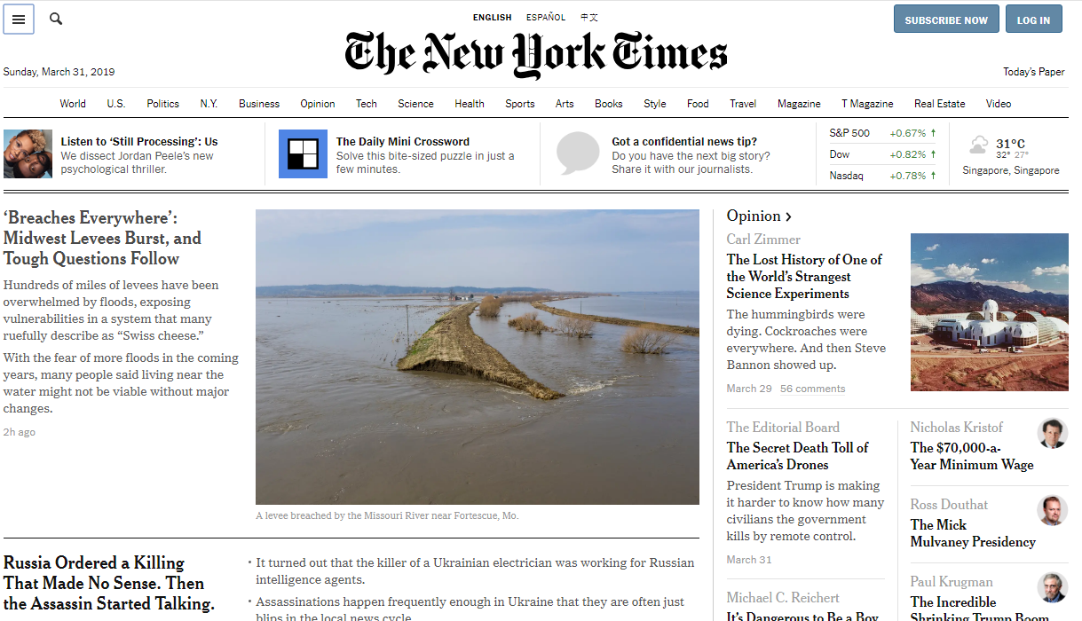
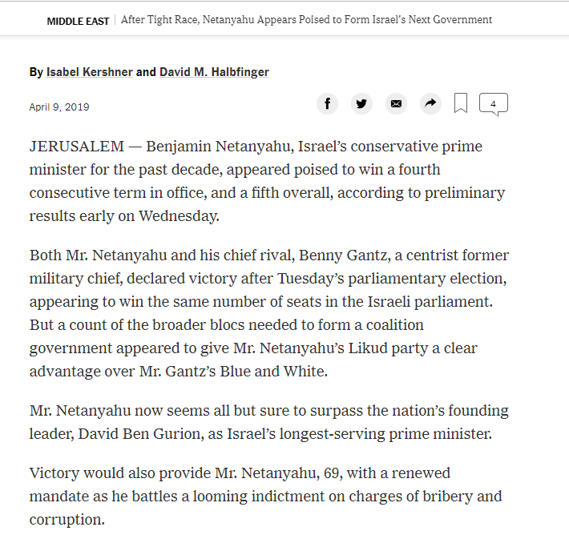
Project analysis slide 4
Scenario & Issues
Increasing trend of
online news consumption
Issues with existing digitalisation efforts
1
2
Cluttering of articles
Title based
Hard cluster of topic
Long Articles
Take longer to digest
Notes:
In today’s information age, there is an explosion of news articles from various publication centers resulting in multiple selection dilemma by the users. We can see from the picture: the volume of online news consumption has rapidly increased while the volume of television has decreased.
There are 2 main issues in current news digitalization.
The first is cluttering of articles which is not user friendly. Topics are usually title based displayed and hard clustering which means one article one topic. The second is articles are too long and too detailed for users to digest.

Slide 4
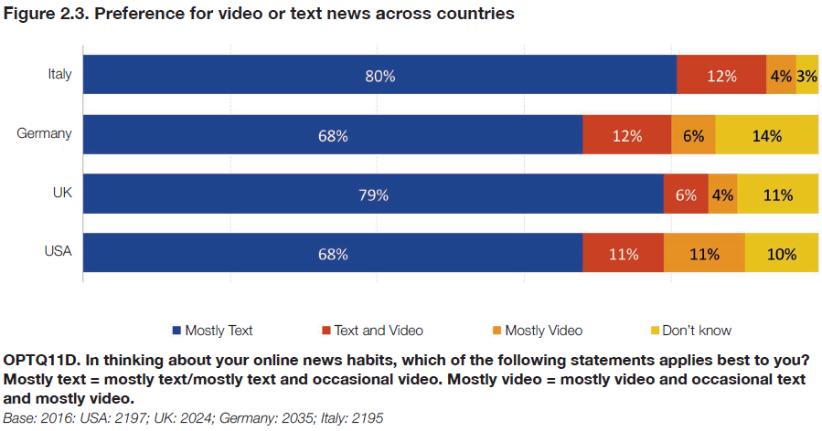
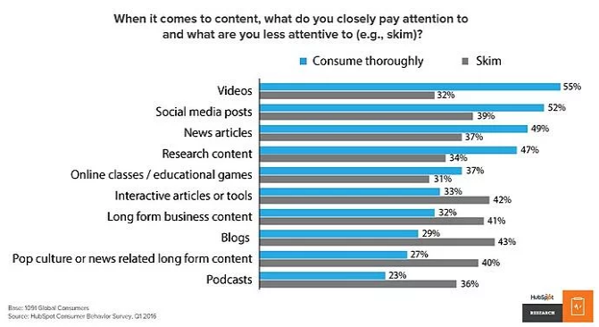
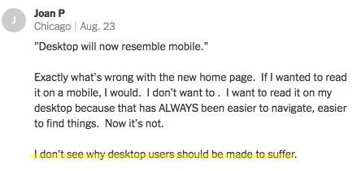
Project analysis slide 4
Users Analysis
Text over video News
Convenient Platform
Concise Articles
Most online readers prefer reading news = quicker
Want easy navigation
Long articles = skimming instead
Below is an extract of reader’s feedback for New York Times website revamp
Need to meet users requirement of T.C.C.
Notes:
Then, let us take a look at what users really want.
Users prefer text over video news since most users find reading news is quicker.
Users also like convenient platform and easy navigation.
Last, users like concise articles. A large proportion of readers tend to skim through long articles instead.

Slide 5
Project analysis slide 4
GAP Analysis
Existing News Digitalisation
GAP!
Users Preference
Cluttered News Publication Platforms
TEXT News
Frustrated Users
CONVENIENT Platform
Need to Address
Long Articles
CONCISE ARTICLES
Skimming of Articles
Notes:
Now we can see the gap between business side and user side: Cluttered news publication platforms will frustrate users and long articles result in skimming.

Slide 6
Project analysis slide 4
Our Solution
Existing News Digitalisation
GAP!
Users Preference
Cluttered News Publication Platforms
TEXT News
TOPIC MODELLING
CONVENIENT Platform
Long Articles
TEXT SUMMARISATION
CONCISE ARTICLES
Notes:
To solve this problem, we decide to apply text mining techniques, using topic modelling to solve the first issue and text summarisation to deal with the second issue.
Next, yuxin will take over to introduce the workflow and data.

Slide 7
Project analysis slide 4
Project Flow
Data Preparation
Data Selection
Methodology
Topic Modelling
Text Summarization
Data Pre-processing
Analysis & Evaluation
LDA Model: Coherence
Summarization: Human Evaluation

Slide 8
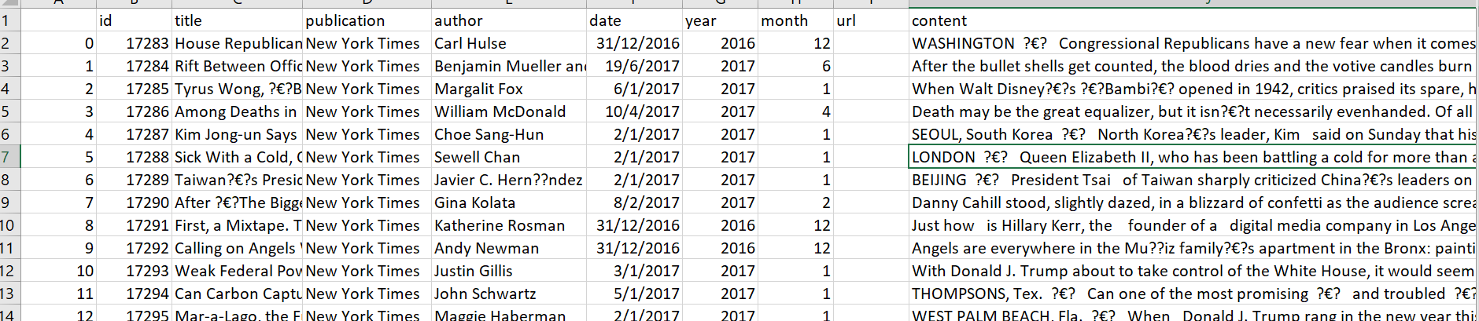
Project analysis slide 5
Data Preparation
Data Challenges
Data Selection
Data Pre-Processing
About 150k Articles
Over 100M words
Computationally intensive
Select 38000 articles from 4 most famous publications
Extract contents and put into separate text files
Tokenization;
Lower case;
Take only alphabets;
Remove stop words.
Notes:
This is the sample of our data. Inicially, there are
Both for running the code and dg the analysis

Slide 9

Project analysis slide 4
By WANG, Yechun

Slide 10
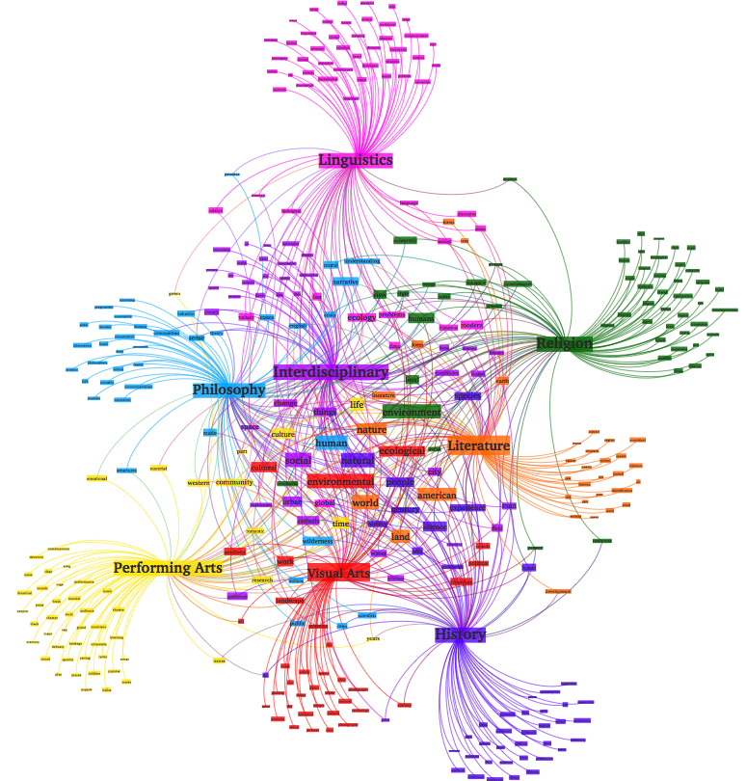
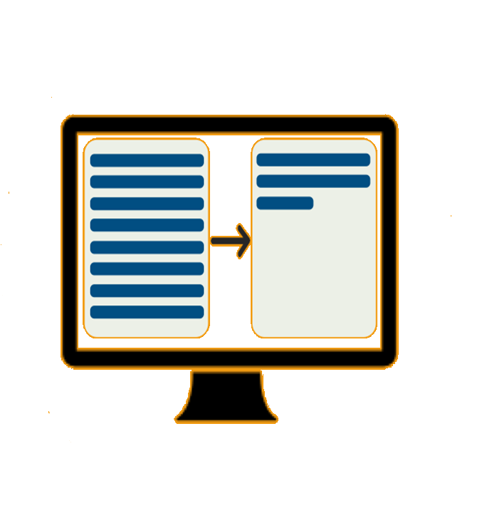
Project analysis slide 4
Topic Modelling
Text Summary

Slide 11
Project analysis slide 4
Topic Modelling
Text Summary

Slide 12
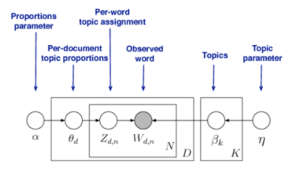
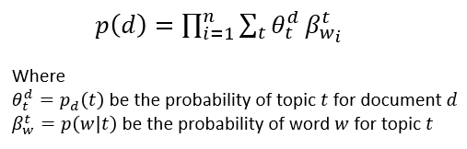
Project analysis slide 8
Methodology 1
Topic Modelling
Need for Clear Topical Selection
Choice: LDA Model
Key Requirement:
Quality of pre processing: stopwords, alphabet etc.
Variety of topics in the corpus
Type of LDA model: Simple LDA
Choice of number of topics: Optimal k
Algorithms tuning parameters: Alpha & eta unchanged
Insight:
Too Cluttered due to title based display
Topics available but few and broad
One article one topic (hard clusters) = need soft clustering

Slide 13
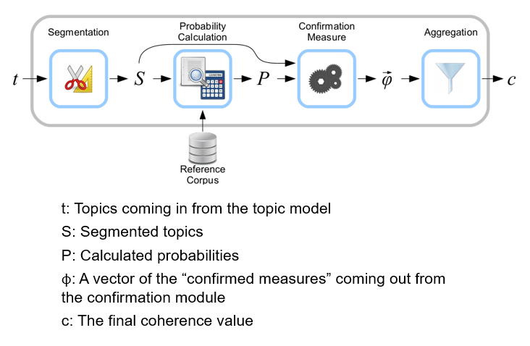
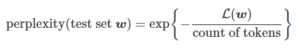
Project analysis slide 6
Results & Analysis 1
Topic Modelling
Model Evaluation
Purpose:
To obtain the optimal number of topics
To ensure the topics are clear and independent.
Perplexity
Coherence
Human Evaluation
Human rate coherence (top 10 words)
Time consuming and inefficient
Only ideal if use concurrently with other methods
Assigns probability to words that actually occur (log-likelihood)
This predictive likelihood and human judgement are often not correlated
Applied to top N words
Pairwise similarity score

Slide 14
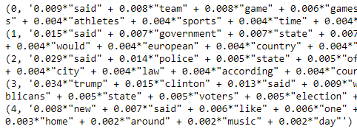
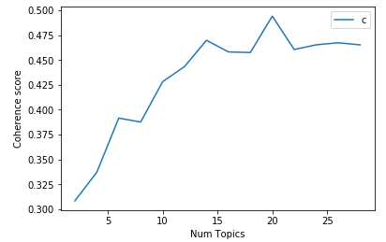
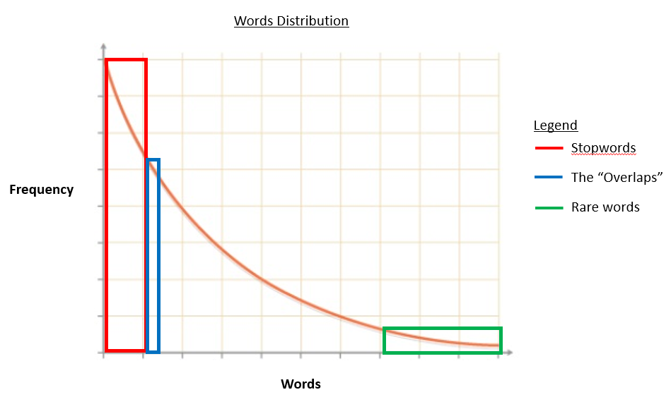
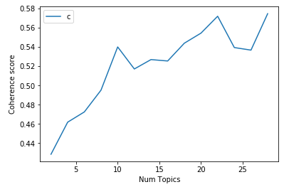
Project analysis slide 6
Results & Analysis 1
Topic Modelling
Insights and Analysis
Performed the LDA model run twice due to observation of noisy words appearance
Appearance of Noisy words in Run 1
Improvement in coherence score after removal of noise
Run 1
Most likely due to ‘Overlaps’
Run 2 after removal of noisy words

Slide 15
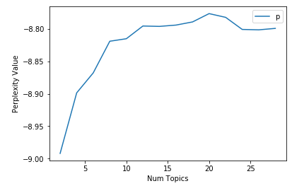
Project analysis slide 6
Results & Analysis 1
Topic Modelling
Insights and Analysis
Have to incorporate other evaluation methods to determine optimal K
Coherence score
Perplexity
Human Evaluation
Varying optimal K (could be due to sub topics)
14, 22 or 28 topics?
Compared the three groups in perplexity
22 topics = optimal
We also look into the top 10 words of each topics in the three groups
22 topics perform better
Final Selection = 22 topics

Slide 16
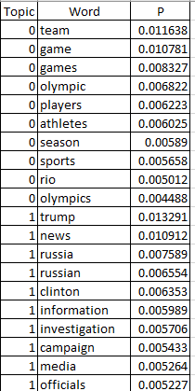
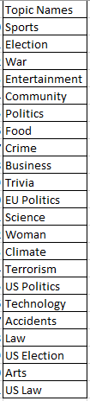
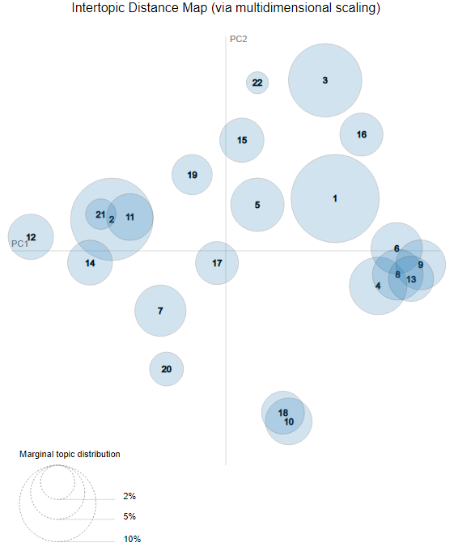
Project analysis slide 6
Results & Analysis 1
Topic Modelling
Insights and Analysis
Analysis of the 22 topics
Topic naming issues
Overlapping of topics observed
Topics given show subtopics
Some topics are obvious
Others are hard as some topics overlap
Two clusters of topic overlapping observed
Could be due to sub topics emerging
Top 10 words produce sub topics occurrence such as Election and US Election

Slide 17
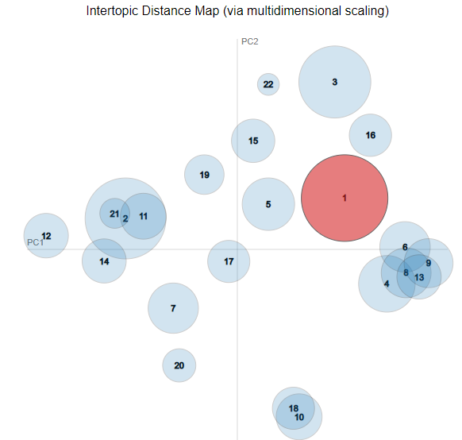
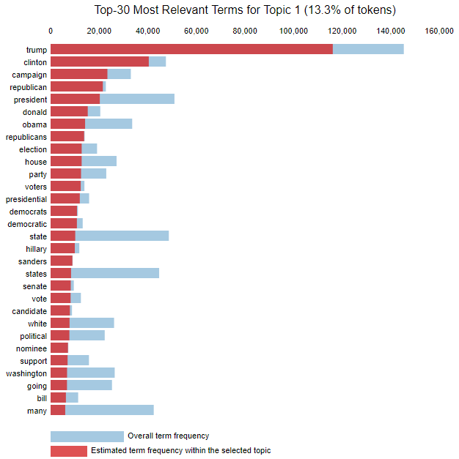
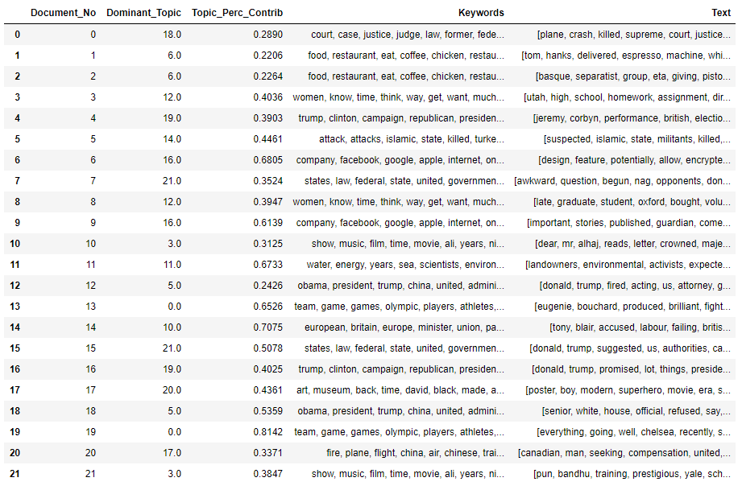
Project analysis slide 6
Results & Analysis 1
Topic Modelling
Insights and Analysis
Analysis of the 22 topics
Multiple topics per article
US ELECTION the HOTTEST topic during this period
Soft clustering success
Dominant topic seems accurate
Insights
Managed to obtain soft clustering
Not all topics are clear and independent

Slide 18
Project analysis slide 4
Topic Modelling
Text Summary

Slide 19
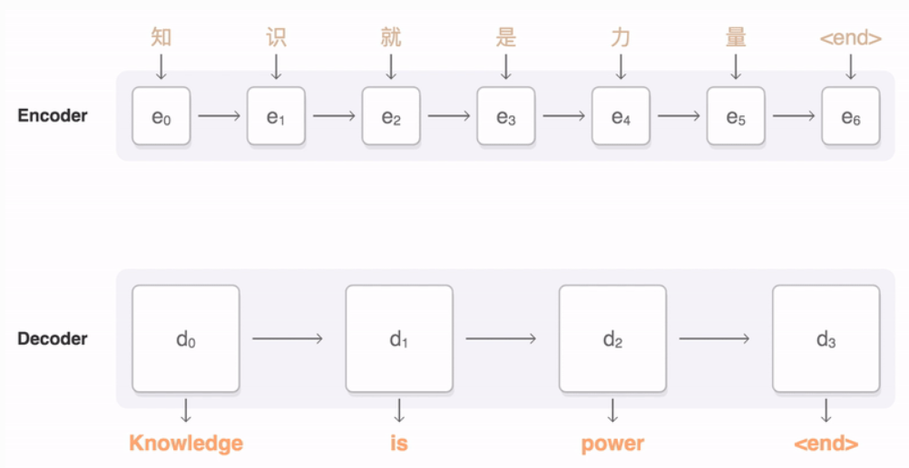
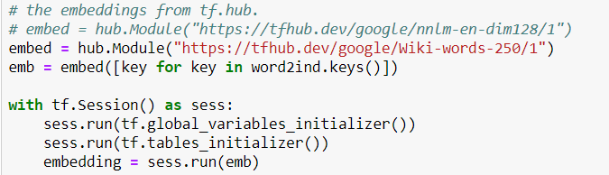
Project analysis slide 8
Methodology 2
Summarization
Pre-trained Embedding
Seq2seq Architecture
Abstractive
(NLP)
Load text document
Text preprocessing
Calculate sentence score
Generate summary
Word frequency table
Set threshold to select sentences
Extractive
Notes:
Let’s talk about the summarization part. We adopt two types of methods. Abstractive and extractive. Abstractive relies on the machine learning. Basically, there is a pre-trained embedding in the NLP already, machine use this mapping to learn synonym. Then with the seq2seq architecture, machine generate its own summary.
For Extractive methods, it seems much more directly and simply as it won’t generate new words or new sentences for the summary. Extractive methods only extract important sentences from the original text. And it works in this flow. After text preprocessing, we create the word frequency table first, then give each word a weight based on its importance to the text, then we score the sentence value by the average word weight and select the important sentence to form the summary.

Slide 20

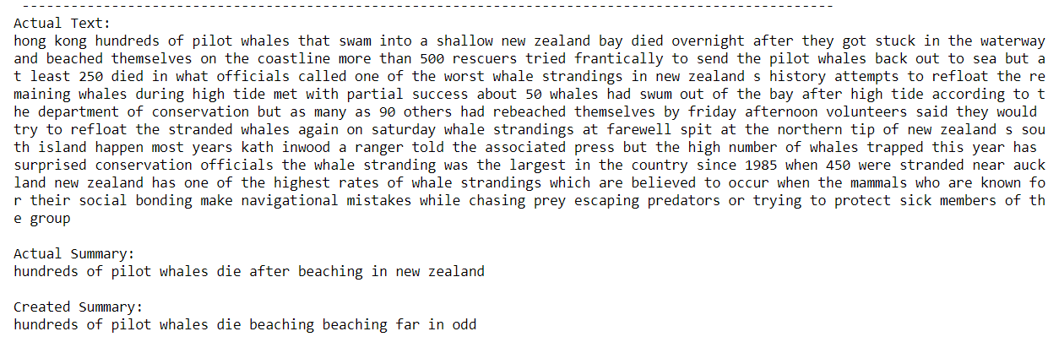
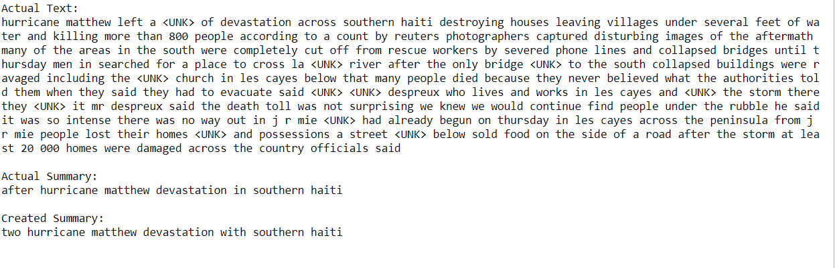
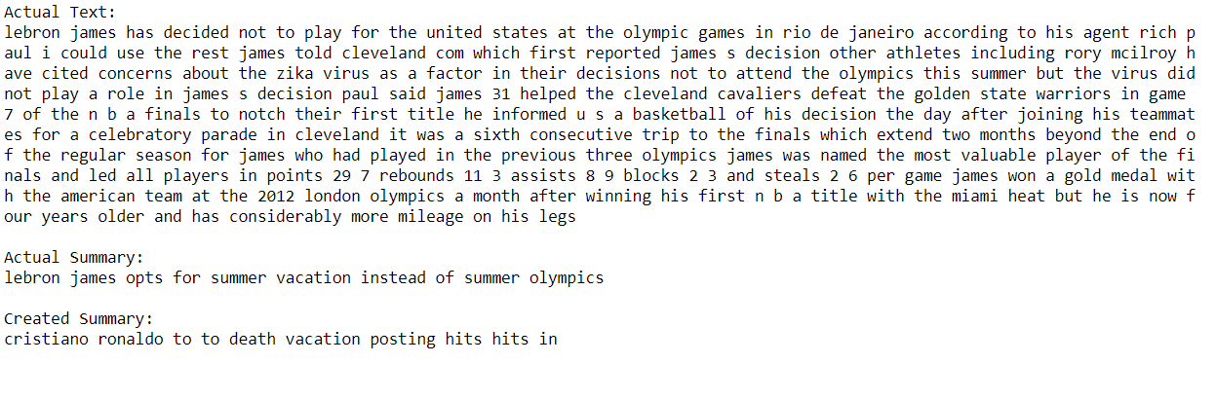
Project analysis slide 6
Results & Analysis 2
Summarization
For the results generated, we found out about 1/3 of the summaries are good, 1/3 are readable while the remaining 1/3 are erroneous.
Abstractive
(NLP)
Extractive
Extractive
Notes:
Let’s go on to the results analysis part.
For the results we generated by the abstractive method, we found out that 1/3 are good, like this, the created summary is the same as the actual summary. And 1/3 are just ok as this two are similarly, the rest 1/3 are bad as they are erroneous. Given such high rate of error, we give up the abstractive method and go on with the extractive method.

Slide 21
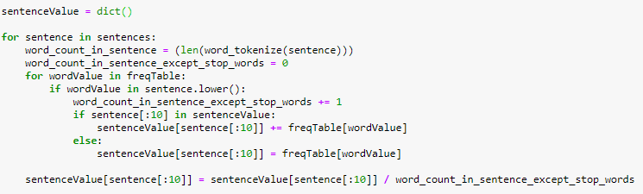
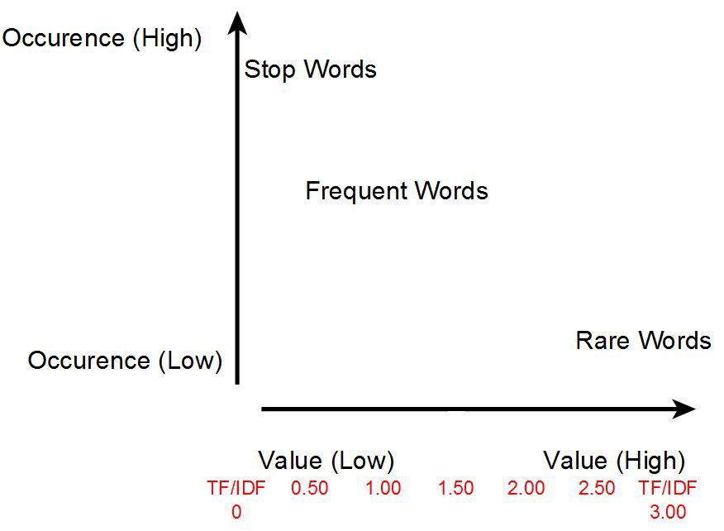
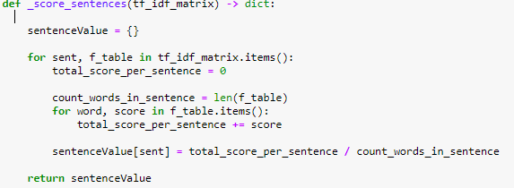
Project analysis slide 6
Results & Analysis 2
Extractive Summarization
Sentence tokenize
Word frequency table
Weight word by TF-IDF and score the sentences
Weight word by frequency and score the sentence
Model Comparison
Average score
TF-IDF
Select
up-to-standard sentences
Set threshold
Generate summary
Notes:
Extractive method can be classified into different types by the algorithms and techniques used to define the weights for the words and sentences. In our project, we use the average score model
and TFIDF algorithms to weigh words and sentences.
As for the comparison, the average score method only take the raw frequency of word in to consideration to weigh the importance, while the tf-idf also take the rare but important word into consideration. So the average score is one dimensional while the tf-idf is bidimensional.

Slide 22
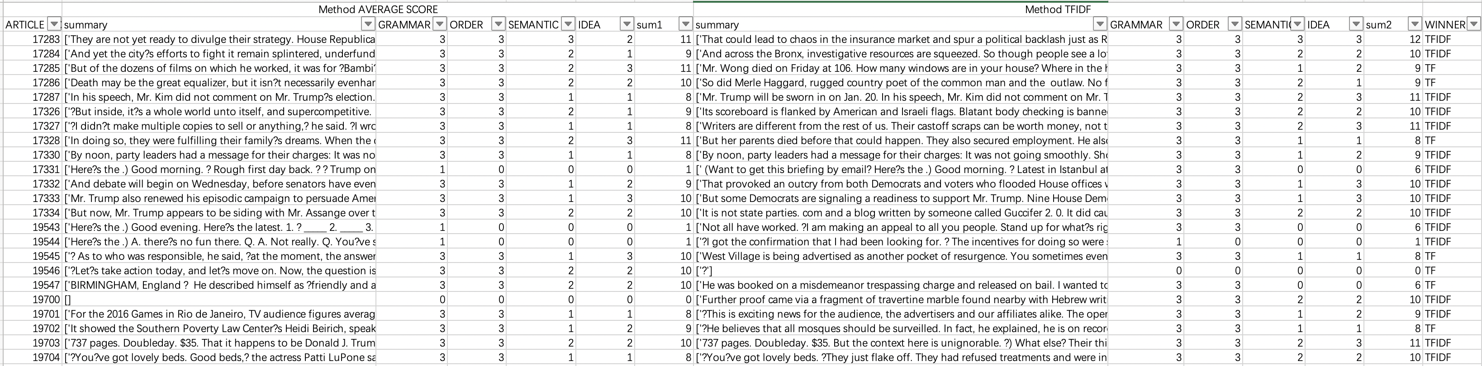

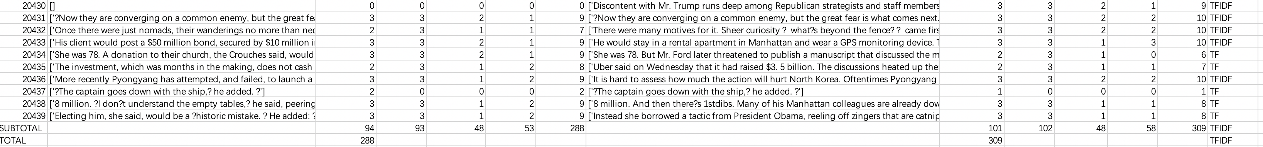

Results & Analysis 2
Extractive Summarization
Analysis & Insight
Evaluation &
summary comparison
Notes:
Let’s see the evaluation of the result generated by the extractive summarization.
We set four criteria to score the summary: grammar, sentences’ order, semantic and summary idea.
Focus on the blue part, it obvious that both methods rank high score in grammar and sentence order. And compared with the average score method, the TFIDF method is much better. What’s more, there are some texts that can get nice summary from both methods.
Ok, let’s focus on the red part. These are the bad ones. The first one is bad as it has many blanks and dashes.
The other red parts show that both methods may generate blank summary in some cases.

Slide 23


Results & Analysis 2
Extractive Summarization
Analysis & Insight
Well
1. The grammar and the structure (sentences order) in the generated summary are basically accurate and correct.​
2.Extractive method matches the texts more concisely and distinctly.
Notes:
So, in summary, the extractive does well in this two aspects.

Slide 24

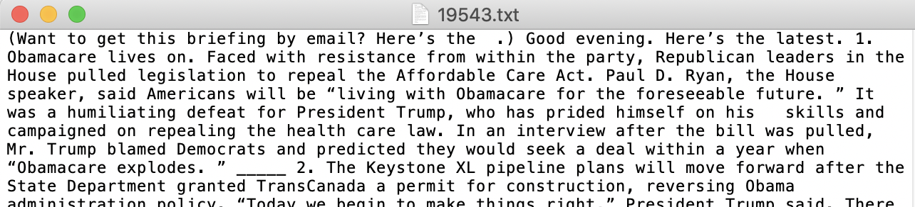
Results & Analysis 2
Extractive Summarization
Analysis & Insight
Bad
1. No summary for the brief
Notes:
We checked the original text, found out it a brief. That is to say, extractive method can not identify the brief and generate the right summary.

Slide 25
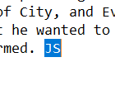
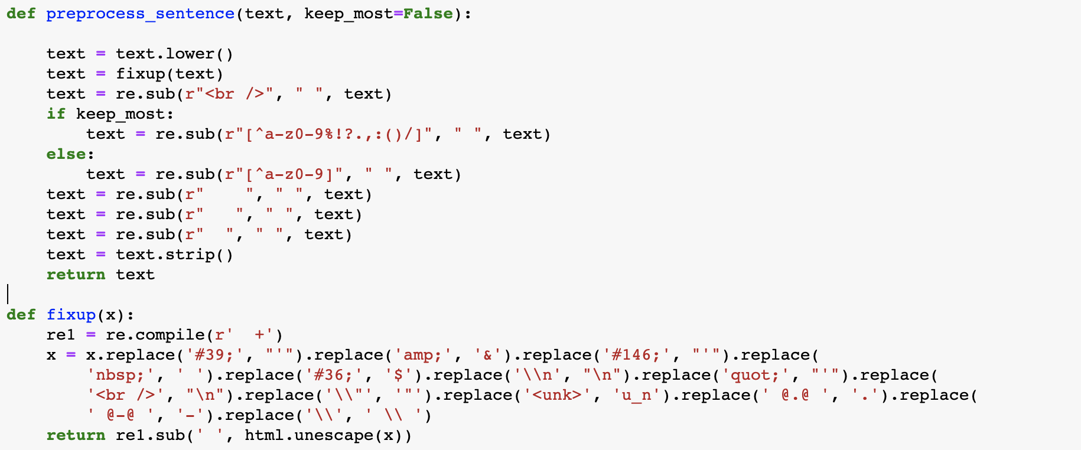
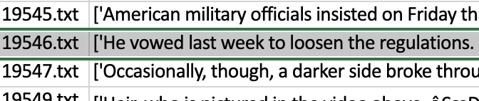
Results & Analysis 2
Extractive Summarization
Analysis & Insight
Bad
No summary for the brief
Data process impacts summarization strongly.
Pre-preprocessed text
Generate new summary
Fit- process function
Notes:
This one is resulted from the data process. Though we have pre-processed in the typical way, but the texts still have some other news-related data problems need to be solved. Like: no punctuation to classify sentence, three continue blanks and unreadable code. So, we reprocess the data and finally generate the new summary.

Slide 26
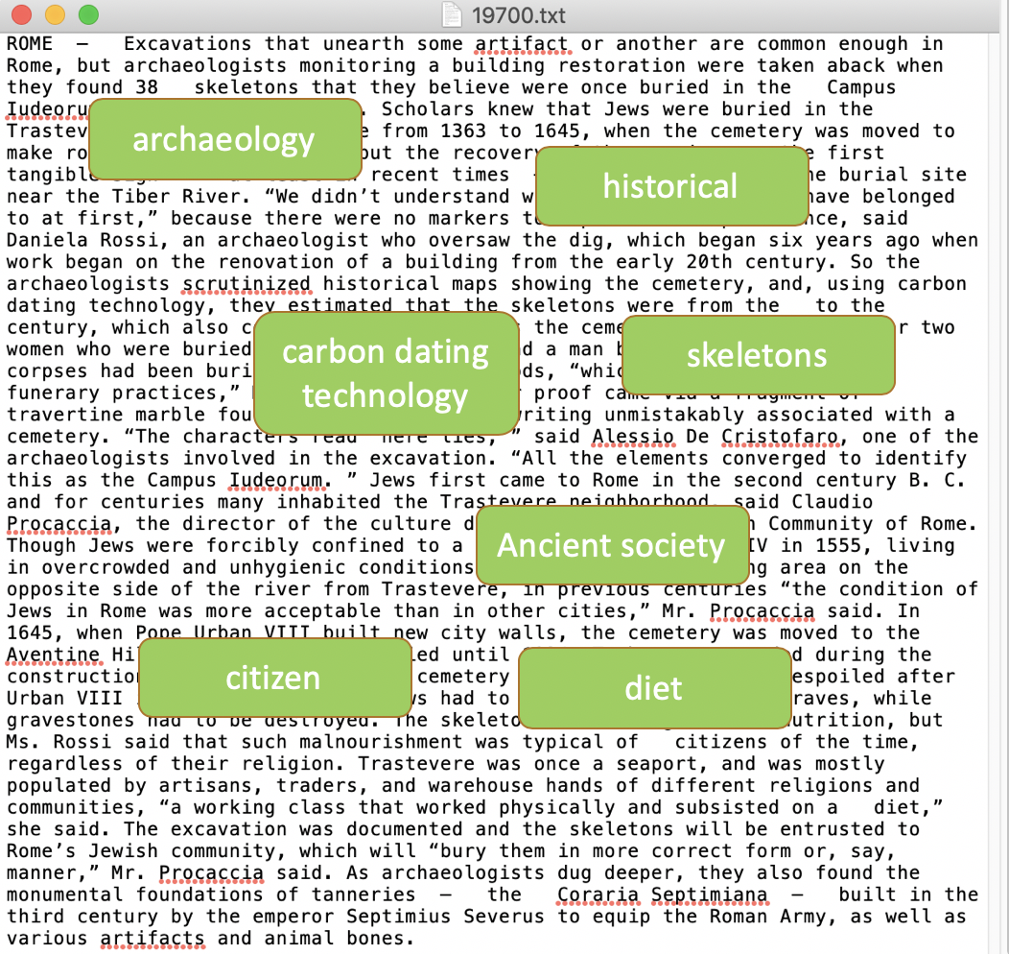
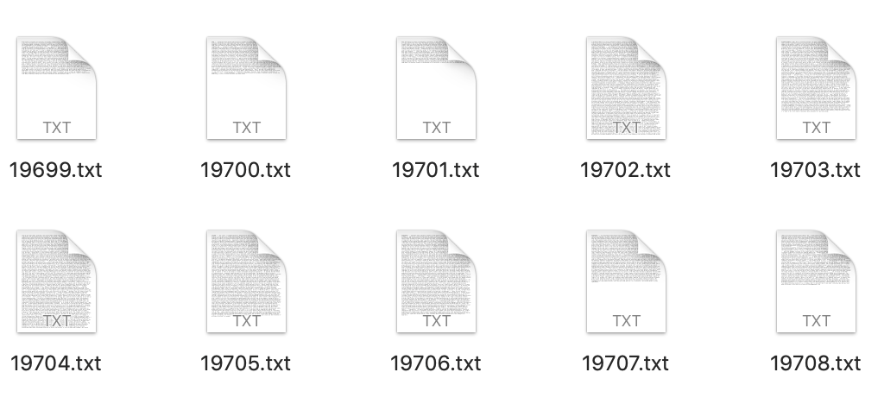


Results & Analysis 2
Extractive Summarization
Analysis & Insight
Bad
No summary for the brief
Data process impacts summarization strongly.
3. Limitation of average score summarization VS. TF-IDF advantage
GUESS 1:
Text size too small while threshold too high?
GUESS 2:
Due to the intrinsic nature of news articles where multiple topics are found, the use of sentence values may not be ideal to form summary.
Notes:
for this one. At first we guess it maybe because the text size is too small and affected by the threshold to get the summary. But like this pic shows, other smaller size texts can get summary. So, this guess is wrong. Then we explore the original text, we found that as the text has related to many topic words,

Slide 27
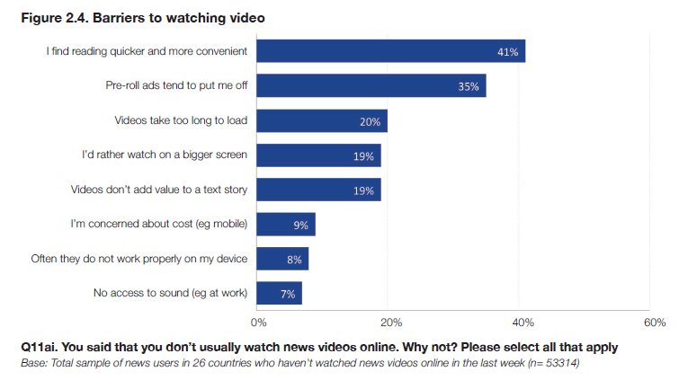

Slide 28
Project analysis slide 8
Limitation
Topic Modelling
Text Summarization
For Abstractive summary:
Lots of rare words in corpus
Requires strong contextual knowledge
For Extractive summary:
Does not take context into account
Unable to find the most important word accurately in the text using weight methods
Unable to determine a flexible summary length for different length documents
Unigram words in our LDA model
Identifying the optimal number of topics might be subjective
Overlapping of topic: Sub topics
A real world implementation issue
Notes:
The model requests someone to label the generated topics, making it impossible for users to obtain immediate news update.
Main issue is that both methods didn't take context into account, so the summarized text is weak in expressing main idea accurately.

Slide 29
Project analysis slide 8
Future Work
Explore the use of other types of topic modelling techniques
(such as bigrams or trigrams , LDA and Latent Semantic Indexing combination model)
Other tools to automatically label the generated topics
Look deeper into the field of NLP and modify existing Abstractive algorithms
Notes:
To eliminate those limitations, here are some future work we can do. Exploring uses of other topic modeling techniques and more advanced tools to name our generated topics can help the work for topic modeling.
The summarization can be improved by deeper look into field of NLP and modifying existing abstractive algorithms.

Slide 30

Convenient & Concise Reading
THE END!
THANK YOU!
ISSS609 Text Analytics and Applications
Project Presentation
Prepared by:
Group 8
JIANG Nan | TEY Wei Jie | WANG Yechun
WANG Yuxin | YAO Yu | ZHU Chenzi

Slide 31



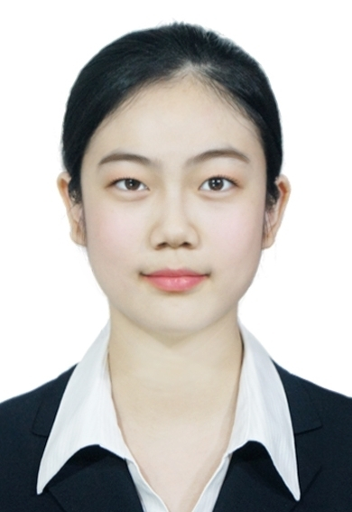


Learning &
Contribution
Teamwork is quite important in such a big project. Thank all my team members!
Combing the power of human and machine is very exciting!
Analysis of unstructured data is useful in the case of news articles summary.
However, there are limitations currently to the things machine can do as seen in this project
Machine learning is really interesting and worth learning. Despite its powerful functionalities, its so difficult!
Jiang, Nan
Data Sourcing and Cleaning & UI
Tey, Wei Jie
Topic Modelling Model
Wang, Yechun
Abstractive Model & UI
Manual evaluation is still very crucial in judging text analytics results.
For text analysis, no separate analysis model, like topic modelling and summarization can influence interactively.
For text summarization, extraction doesn't perform well in general, different word-score methods didn't make much discrimination.
Wang, Yuxin
Powerpoint & Data
Yao, Yu
Extractive Model
Zhu, Chenzi
Evaluation Model

Slide 33
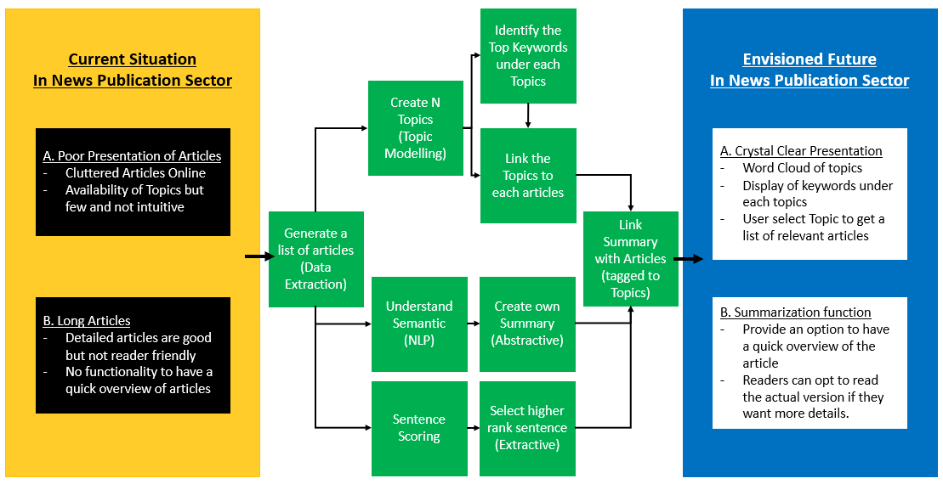
Project analysis slide 5
Appendix 1:
Solution Overview

